Slide 1

SAMPLE-SUPERSTORE DATA ANALYSIS
OBJECTIVE:
Create a dashboard to visualize and compare sales data between two selected regions.
Assist the organization in understanding performance and suggesting improvements.
Dataset:
Sample Superstore
Steps to Perform:
Select Data
Use the Sample Superstore dataset.
Organize Data
Group data by Customer Name and Order ID for thorough organization.
Create Hierarchy
Establish a hierarchy called "Location" for the variable "Country."
Create Parameters
Define two parameters: Primary Region and Secondary Region, listing all regions.
Create Calculated Fields
Generate calculated fields for both Primary Region and Secondary Region.

Slide 2
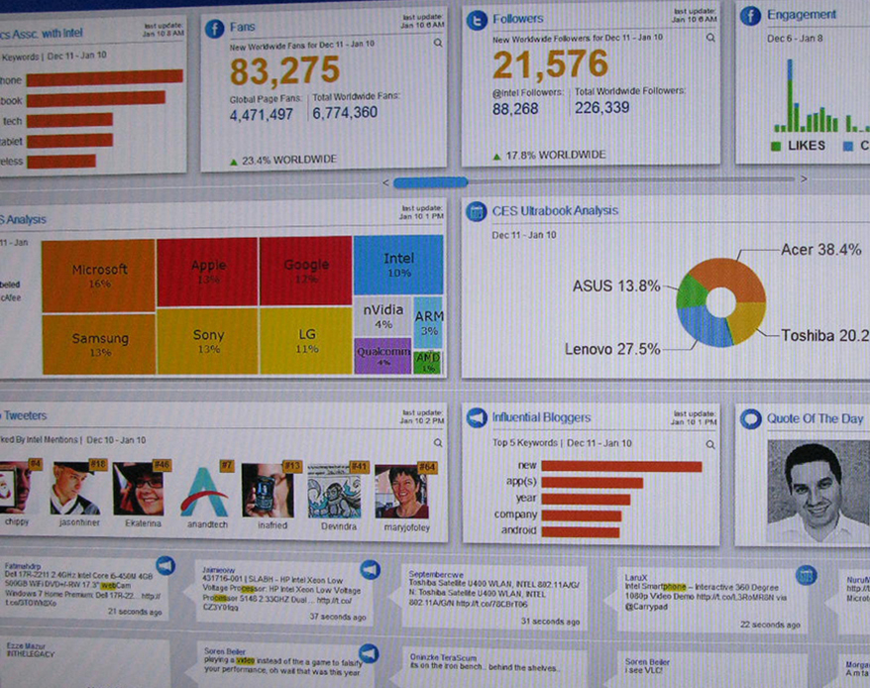
*Determine First Order Date
Create a calculated field named "First Order Date."
*Build Dashboard
1.Align all sheets in the dashboard. 2.Partition the dashboard to display the following details for both Primary and Secondary Regions:
3.First Order Date
4.Total Sales
5.Average Sales per Order
6.Number of Customers
7.Number of Orders
8.Number of Products in Sale
*Summary
1.The dashboard will enable upper management to visualize and compare sales data between two regions. 2.It will provide insights for performance evaluation and improvement suggestions.

Slide 3
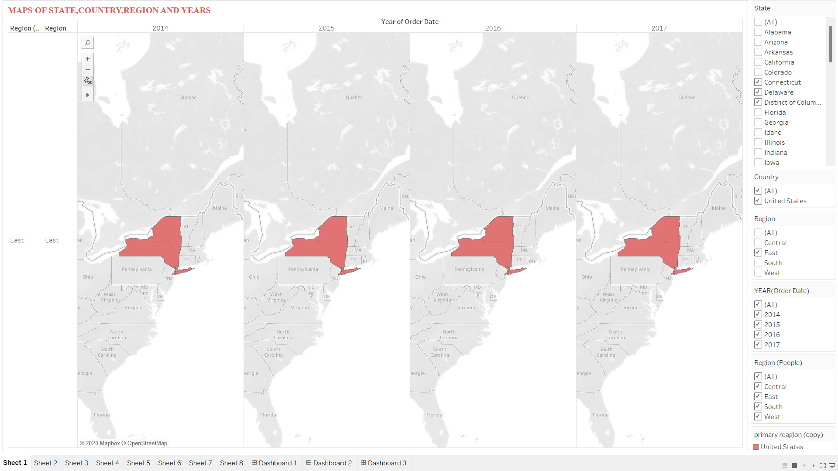

Slide 4
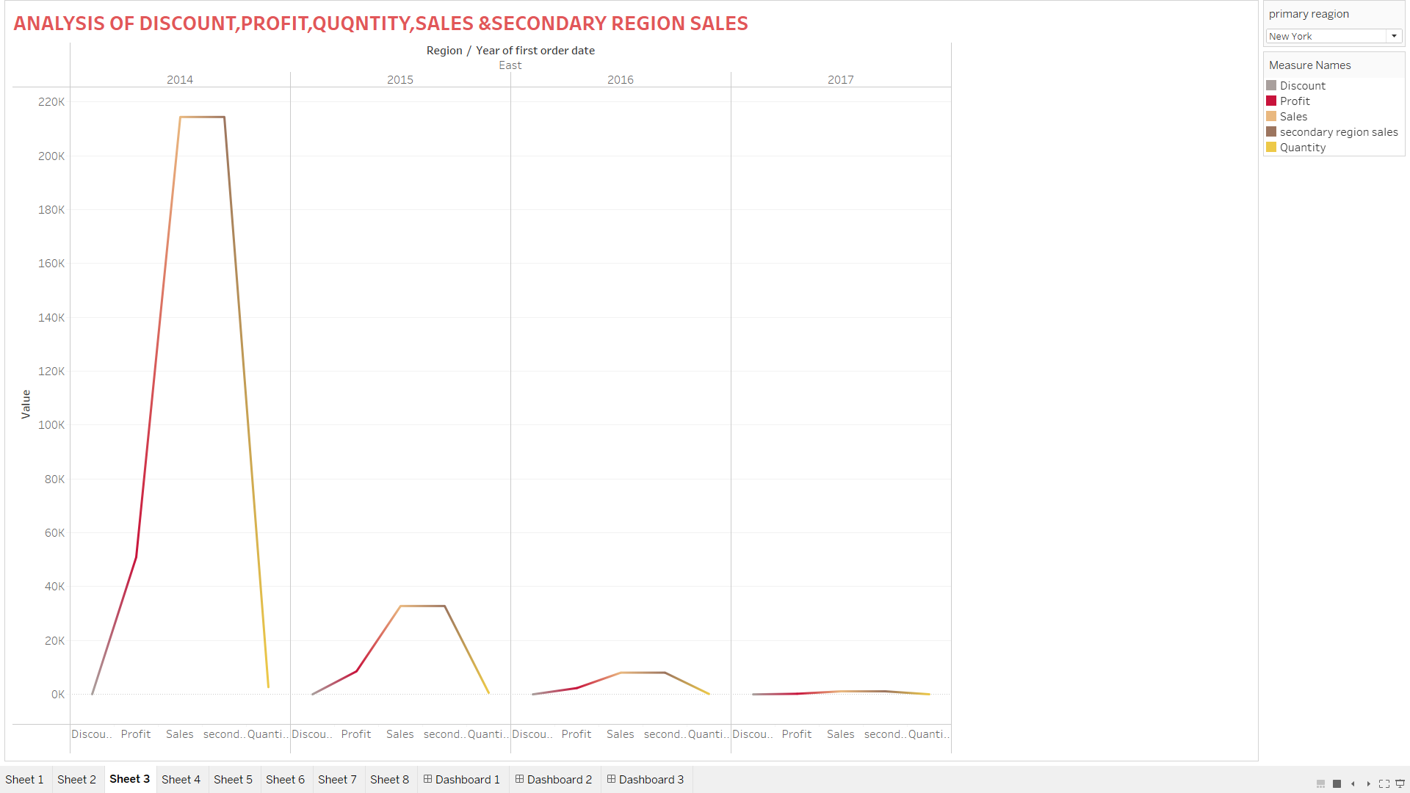

Slide 5
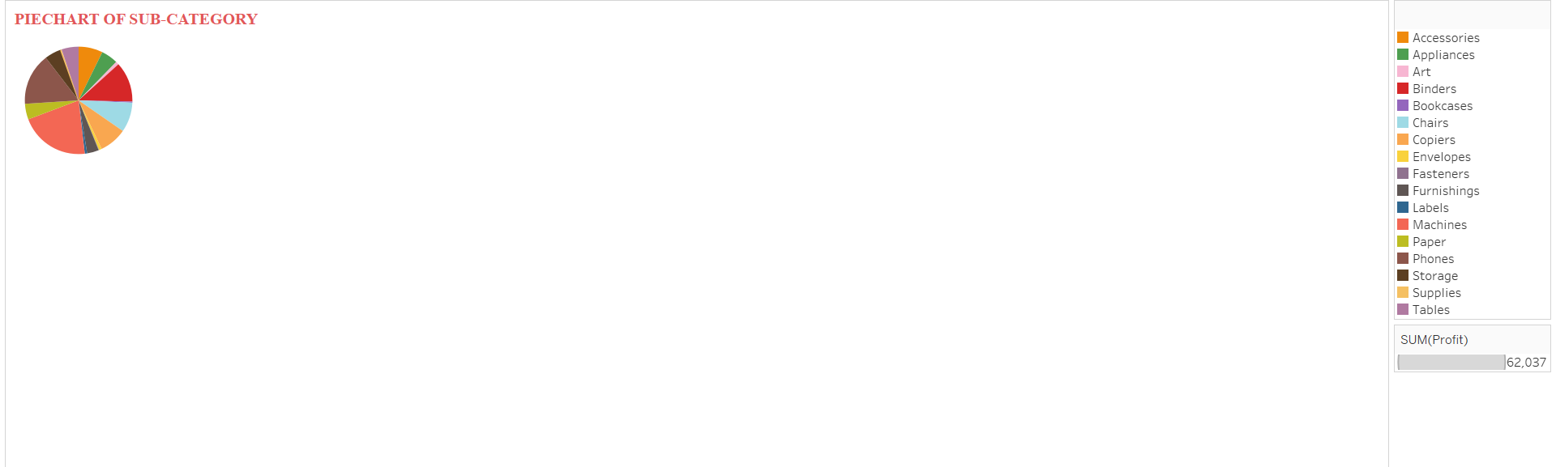
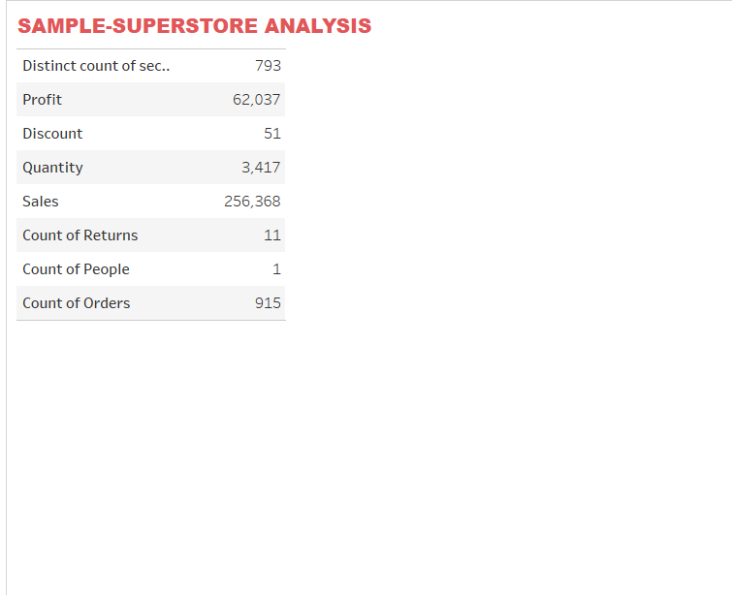
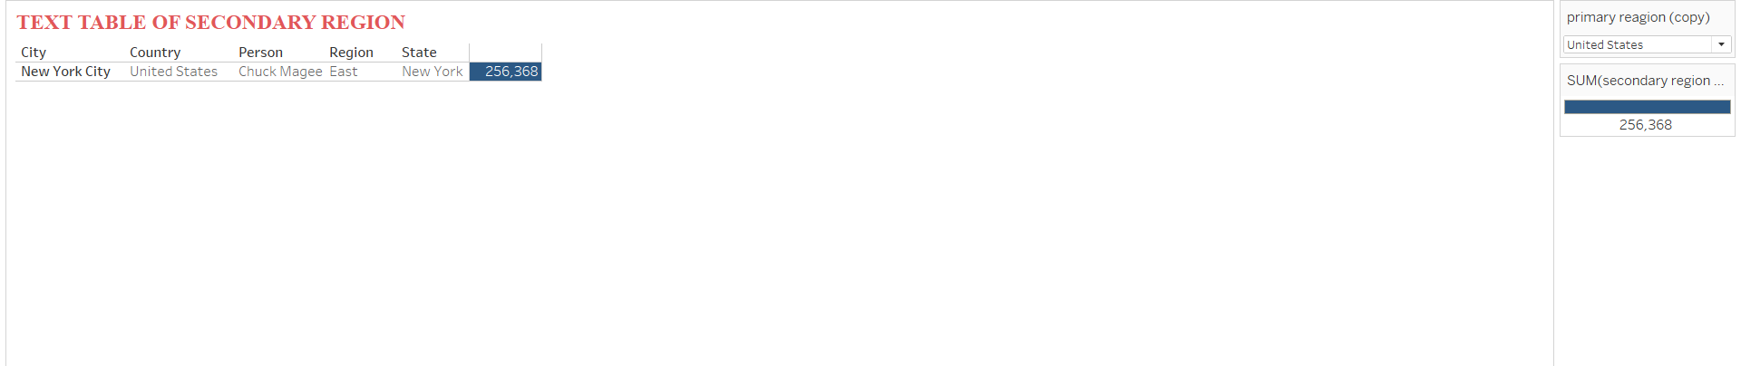

Slide 6
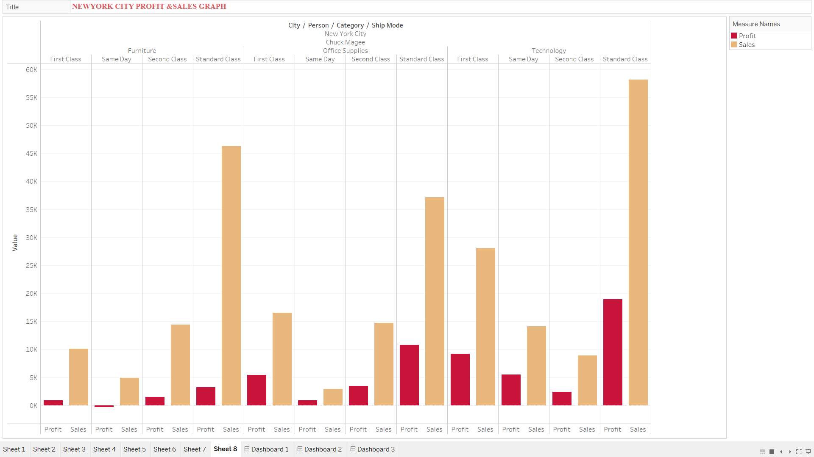
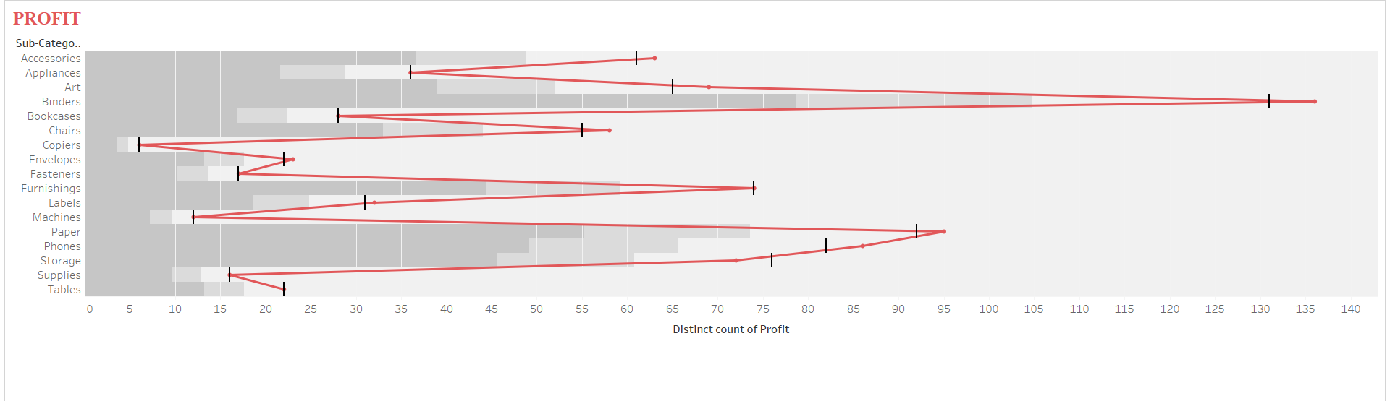

Slide 7
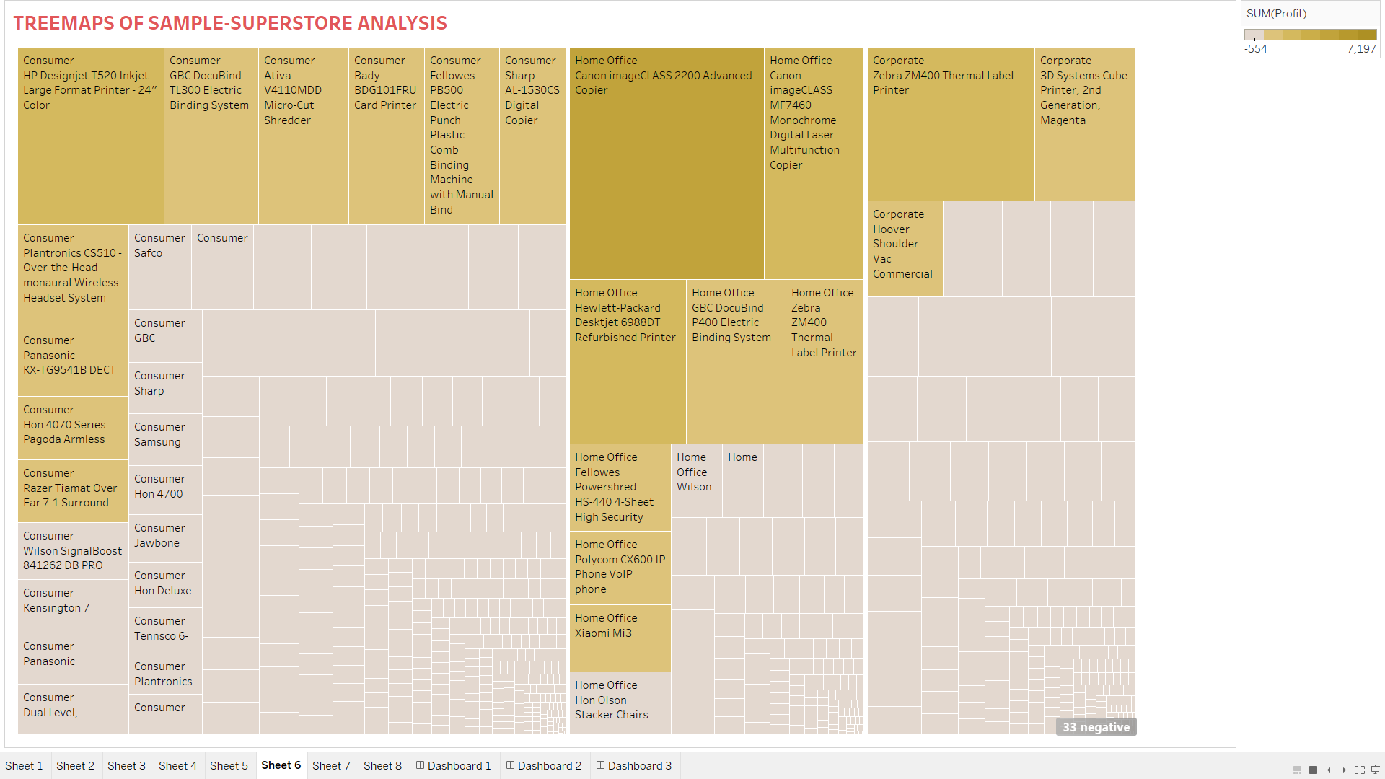

Slide 8
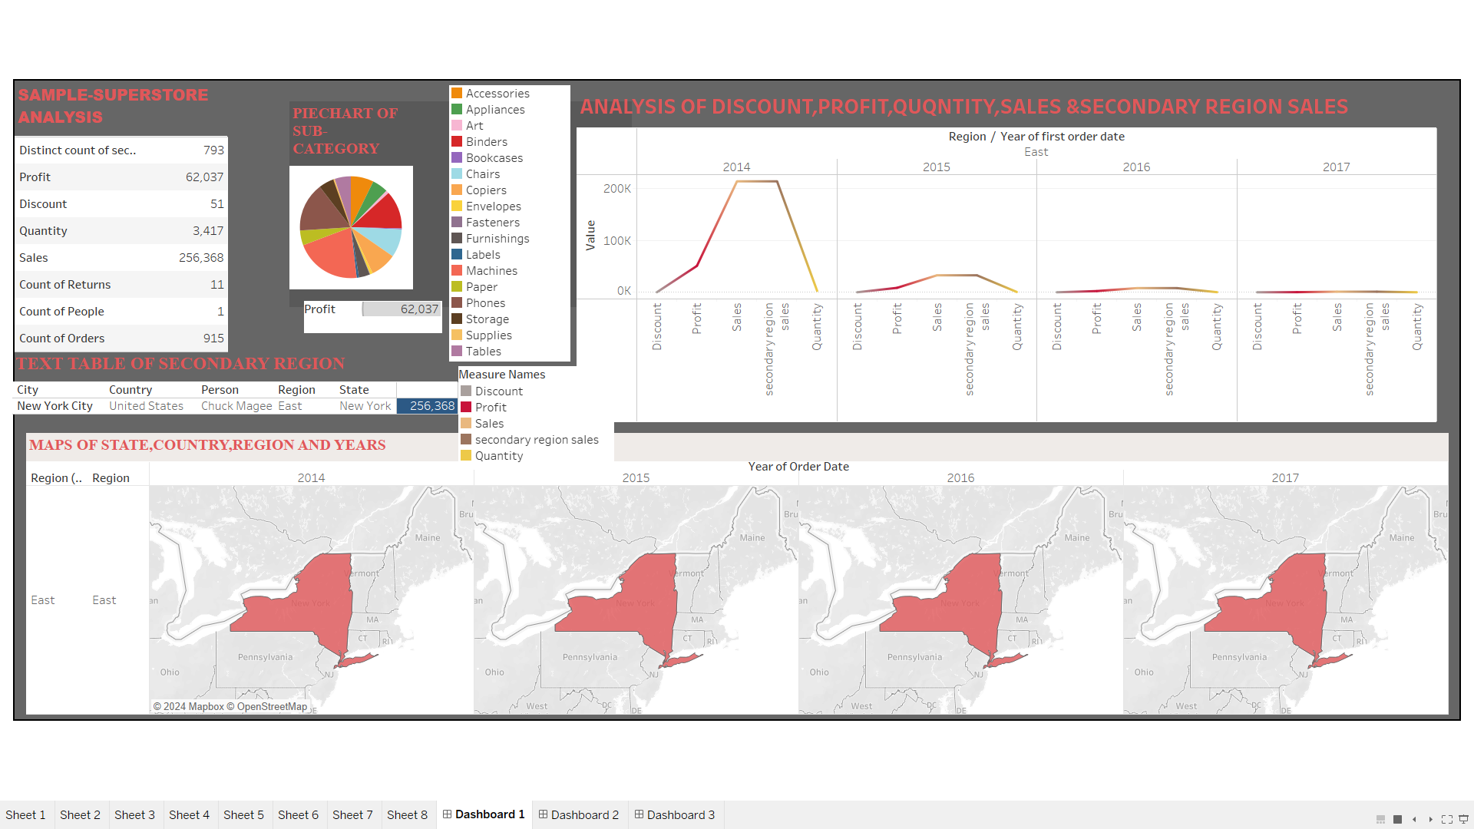

Slide 9
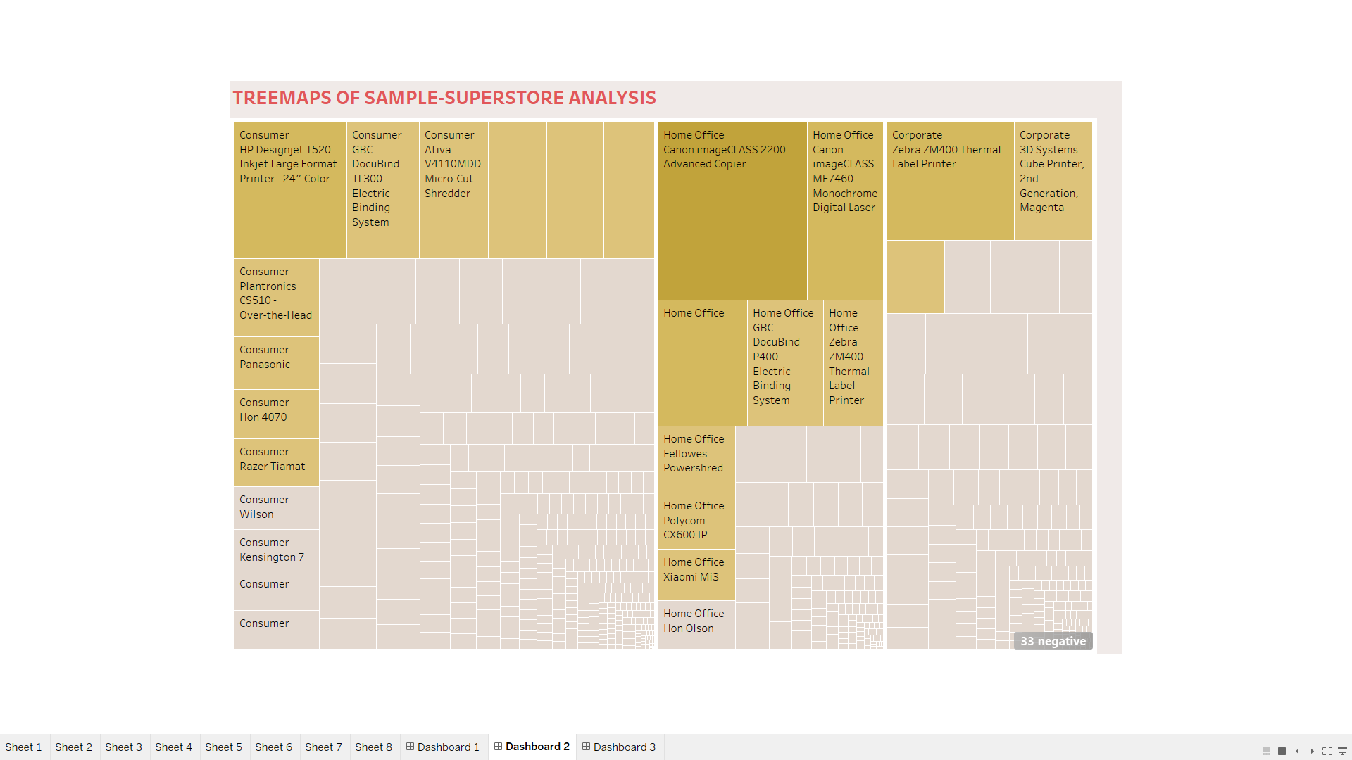

Slide 10
